Slide 1
Performance Tasks
Ervie A Benliro
ICT 11-C

Slide 2
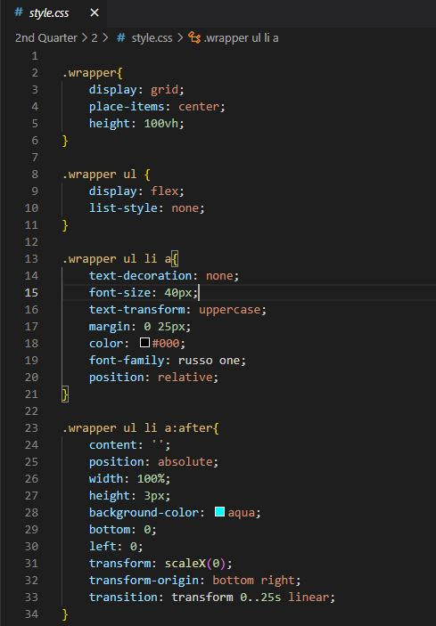
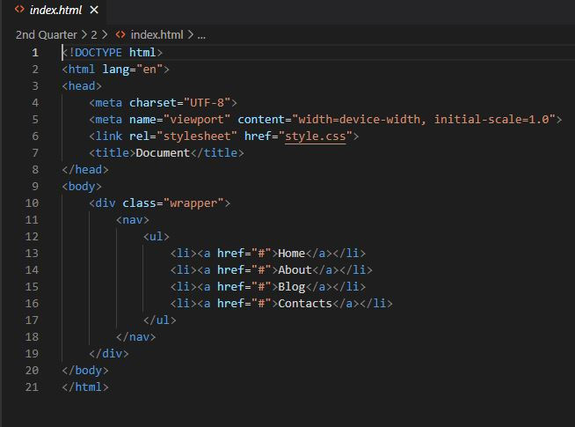

CSS Hover Activity 2 (2nd Quarter)

Slide 3
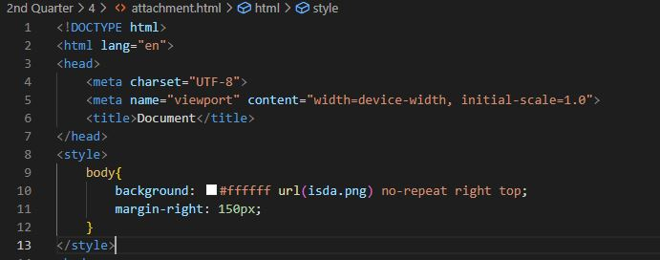
CSS Background Image Activity 4 (2nd Quarter)

Slide 4
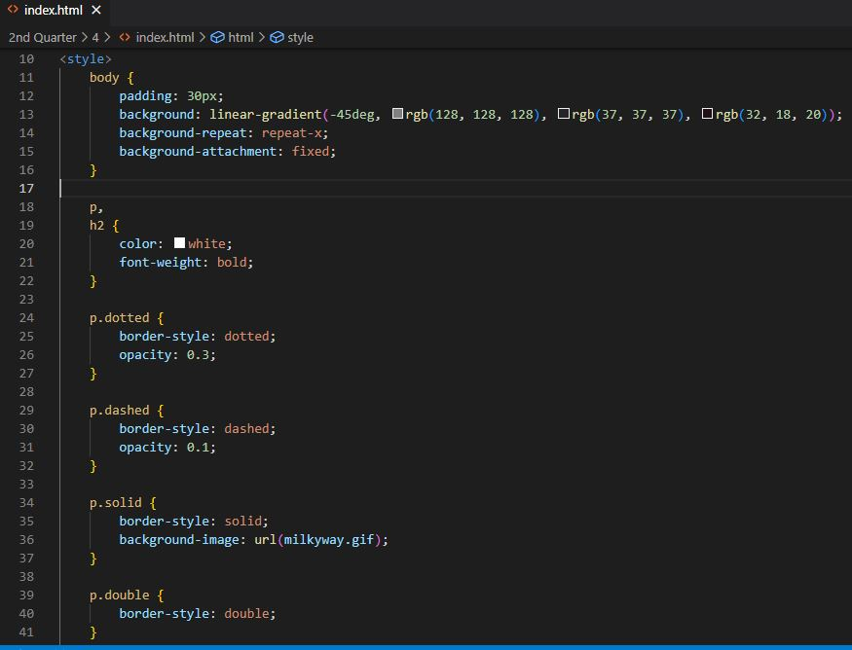
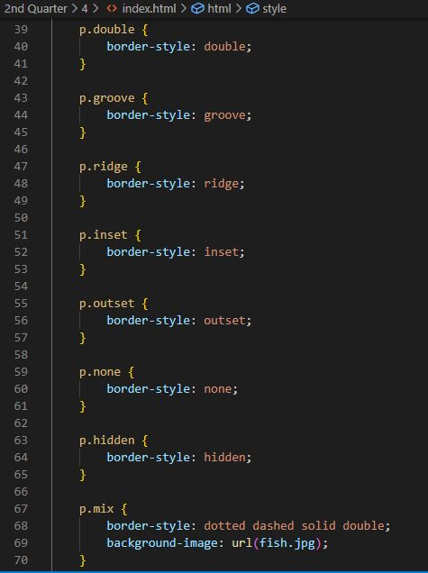
CSS Border Activity 4 (2nd Quarter)

Slide 5
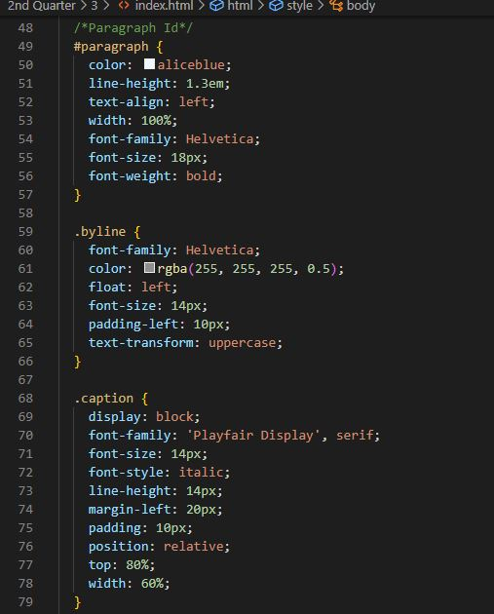
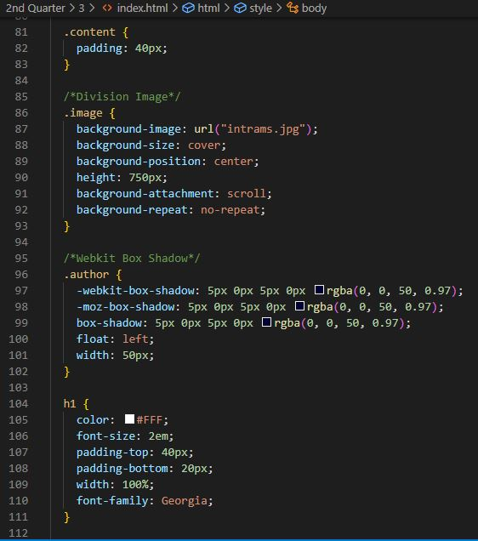
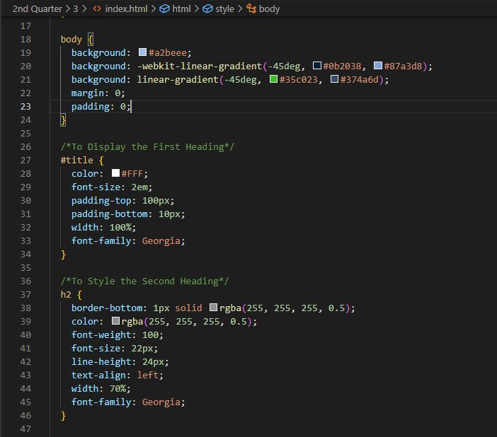
CSS Comments Activity 3 (2nd Quarter)

